Slide 1

Object Oriented Analysis and Design using Java
UE19CS353
Prof. Mahitha G and Prof. Sindhu R Pai
Department of Computer Science and Engineering

Slide 2

UE19CS353: Object Oriented Analysis and Design using Java
State Modelling – Part 1
Prof. Mahitha G and Prof. Sindhu R Pai
Department of Computer Science and Engineering

Slide 3
Object Oriented Analysis and Design using Java
Agenda
Introduction
Events
Event types
States
Events v/s states
Transitions
Guard conditions
State diagrams
UML Notations
Sample state diagrams
One - shot state diagrams

Slide 4
Object Oriented Analysis and Design using Java
Introduction
Describes the sequence of operations that occur in response to external stimuli as opposed to what the operations do, what they operate on or how they are implemented.
Consists of multiple state diagrams, one for each class with temporal behaviour that is important to an application.
State diagrams must match on their interfaces – event and guard conditions
The individual state diagrams interact by passing events and through side effects of guard conditions

Slide 5
Object Oriented Analysis and Design using Java
Events
An occurrence at a given point in time, that an application considers atomic and fleeting.
Often corresponds to a verb in past sense or on the onset of condition
Examples: User depresses a button, customer reports a problem, shipment arrives
Happens instantaneously with regard to the time scale of application
Represents a named object that is dispatched (thrown) asynchronously by one object and then received (caught) by another
The time at which an event occurs is an implicit attribute of an event.

Slide 6
Object Oriented Analysis and Design using Java
Events contd..
Events could be
Normal as well error conditions
External as well as Internal
Related as well as unrelated(Concurrent)
Concurrent events:
Two events are unrelated and have no effect on each other.
The communication delay between two locations exceeds the difference in event times
Related events
One event may logically precede or follow another.

Slide 7
Object Oriented Analysis and Design using Java
Types of Events
Signal Event
Explicit one way transmission of information from one object to another
Event of sending or receiving a signal
Change event
Event caused by the satisfaction of a boolean expression
Time event
Event caused by the occurrence of an absolute time or the elapse of a time interval

Slide 8
Object Oriented Analysis and Design using Java
Signal event
An object sending a signal to another object may expect a reply, but the reply is a separate signal under the control of the second object, which may or may not choose to send it.
Signal is a message between objects, whereas signal event is an occurrence in time
Every signal transmission is a unique occurrence, but they are grouped to signal classes with a class name to indicate common structure and behavior.
May also have attributes indicating values they convey
Represented in UML as <<signal>> on top of class name

Slide 9
Object Oriented Analysis and Design using Java
Change event
The intent is that the expression is continuously tested.
Whenever the expression changes from false to true, the event happens
Generally detected by polling or other application logic
UML notation is using when (expression)
Examples:
when (inventory < reorder point)
when (storage used > maximum allowable)
when (altitude < 10000)
when (room temperature < heating set point )

Slide 10
Object Oriented Analysis and Design using Java
Time event
UML notation is using
when (expression)
after (expression)
Example: -- when (date = November 1, 2011) -- after (10 seconds)

Slide 11
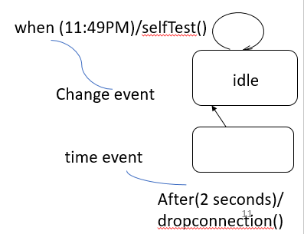
Object Oriented Analysis and Design using Java
Event Types - Examples
«signal»
MouseButtonDown
button
location
when (11:49PM)/selfTest()
idle
Change event

Slide 12
Object Oriented Analysis and Design using Java
States
An abstraction of values and links of an object. Sets of values and links are grouped together into a state according to the behaviour of objects.
Correspond to verbs with a suffix of “ing” (Waiting, Dialing) or the duration of some condition (Powered, BelowFreezing)
Objects of a class have a finite number of possible states. But each object can only be in one state at a time.
State specifies the response of an object to input events.
All events are ignored in a state, except those for which behaviour is explicitly prescribed.

Slide 13

Object Oriented Analysis and Design using Java
Events v/s states
Events corresponds to a specific points in time
States represent intervals of time between two events received by the object

Slide 14
Object Oriented Analysis and Design using Java
Transitions
An instantaneous change from one state to another
Fires when event occurs
Said to fire upon the change from source state to target state
The origin and target of a transition usually are different states but could be the same.
The choice of next state depends on the original state and event received
The event may cause multiple objects to transition
Example: When a phone line is answered, the phone line transitions from the Ringing state to the Connected state.

Slide 15
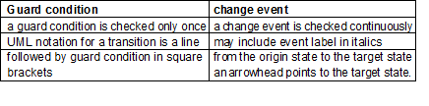
Object Oriented Analysis and Design using Java
Guard conditions
Boolean expression that must be true for transition to occur
Checked only once, at the time when event occurs
Example: When you go out in the morning (event), if the temperature is below freezing (condition), then put on your gloves (next state).
Guard condition vs change event

Slide 16
Object Oriented Analysis and Design using Java
State diagram
A graph whose nodes are states and directed arcs are transitions
Specifies state sequences caused by event sequences
State names must be unique within the scope of a state diagram
There can be only one start state and many intermediate and final states
An object must be in some specific state at any given time
If more than one transition leaves a state, first event occurred decides the transition to fire
If an event occurs, no transition matches it, then the event is ignored
If an event occurs and if more than one transition matches it only one will fire but the choice is non-deterministic.

Slide 17
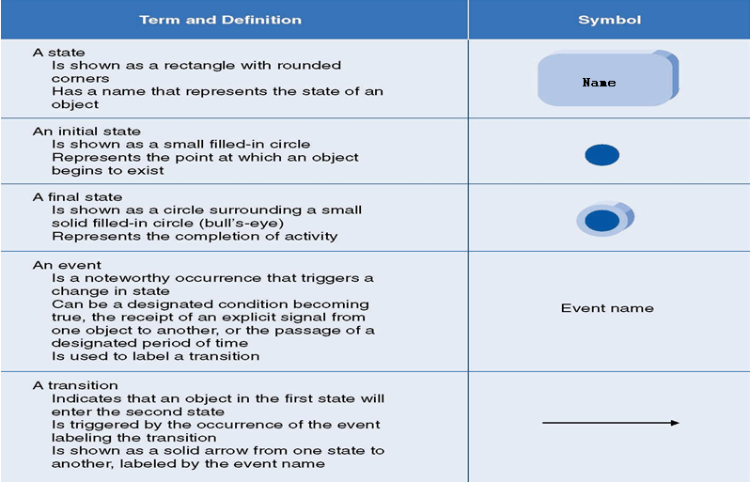
Object Oriented Analysis and Design using Java
UML Notations - State diagram

Slide 18
Object Oriented Analysis and Design using Java
Summary of State diagram notation
Event: Signal event shown as a label on a transition and may be followed by parenthesized attributes. Change event - when (Boolean expr) Time event – when (time) or after (time duration)
State
Solid box .. Could have start state circle and final state bulls eye
State diagram with the diagram name in the left upper corner
State diagram Name
Guard condition
State 1
do/activity
event/effect
State 2
do/activity
event/effect
event (attributes) [condition]/effect
Transition
Drawn as a line from the original state to the end state. Arrow head points to the target state.
Effect: Behaviour in response to an event
Event can be entry, exit, etc.
Do activity continues as long as the object is in that state

Slide 19
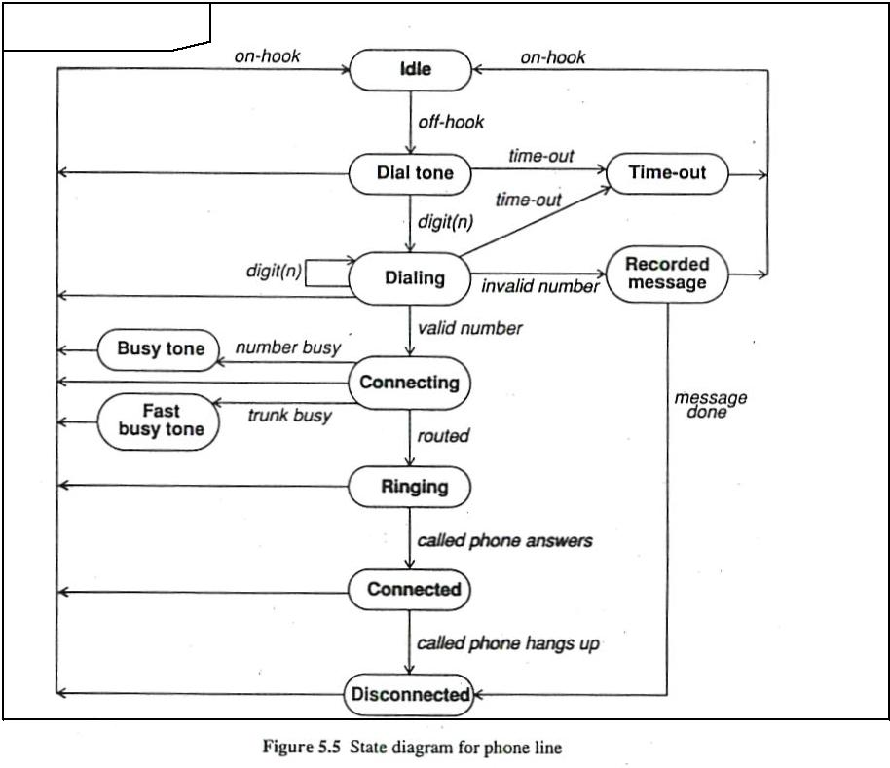
Object Oriented Analysis and Design using Java
Sample State diagram
State
Phone line
Event
Event

Slide 20
Object Oriented Analysis and Design using Java
Sample State diagram
Traffic Signal
Traffic Light
Start
State
Red
Transition
Yellow timer expires
Red timer expires
Yellow
Green timer expires
Green
Event
‹#›

Slide 21
Object Oriented Analysis and Design using Java
One – shot State diagrams
Represent objects with finite levels and have initial and final states.
The initial state is entered on creation of an object
Entry of the final state implies destruction of the object.
Object created in a state and change of the state deletes the object
As an alternate notation, you can indicate initial and final states via entry and exit points.
Entry points (hollow circles) and exit points (circles enclosing an "x") appear on the state diagram's perimeter and may be named.

Slide 22
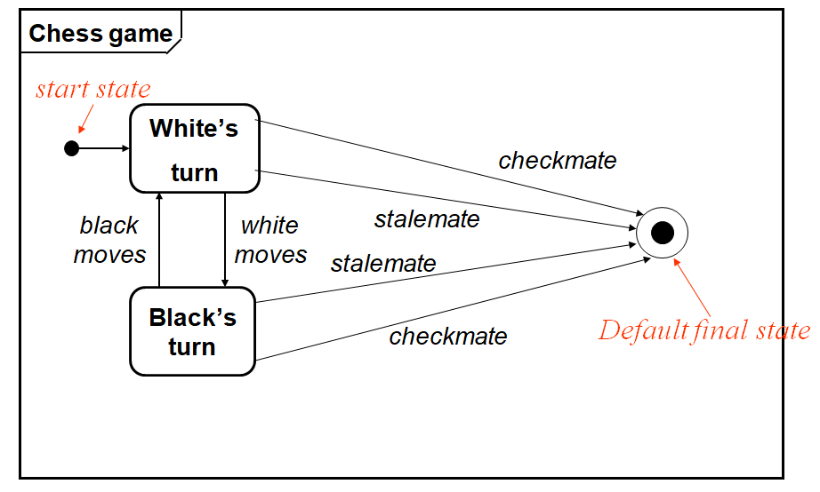
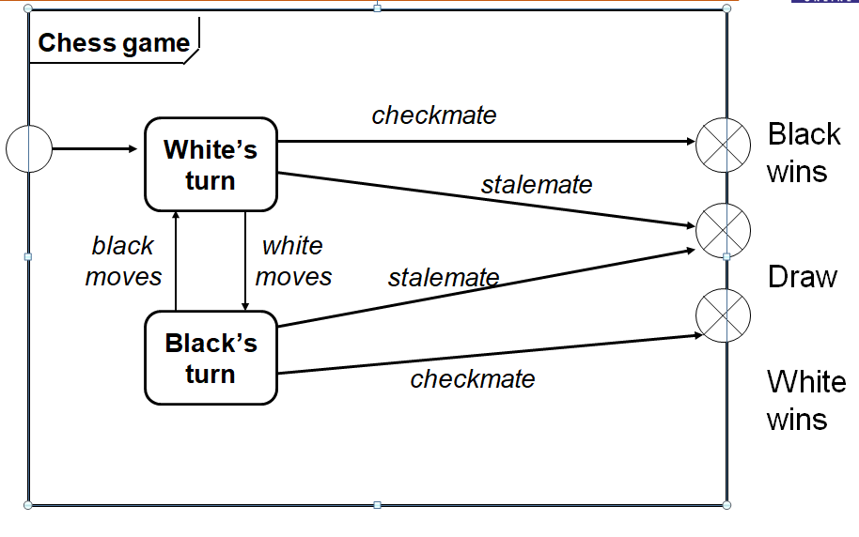
Object Oriented Analysis and Design using Java
One – shot State diagrams

Slide 23
References
Text Book: Object Oriented Modeling and Design with UML, by Michael R Blaha and James Rumbaugh.

Slide 24
THANK YOU
Prof. Mahitha G and Prof. Sindhu R Pai
Department of Computer Science and Engineering
mahithag@pes.edu
sindhurpai@pes.edu
+918277606459

